Slide 1

Processes Concepts

Slide 2
Process Scheduling
Maximize CPU use, quickly switch processes onto CPU for time sharing
Process scheduler selects among available processes for next execution on CPU
Maintains scheduling queues of processes
Job queue – set of all processes in the system
Ready queue – set of all processes residing in main memory, ready and waiting to execute
Device queues – set of processes waiting for an I/O device
Processes migrate among the various queues

Slide 3
Schedulers
Short-term scheduler (or CPU scheduler) – selects which process should be executed next and allocates CPU
Sometimes the only scheduler in a system
Short-term scheduler is invoked frequently (milliseconds) ⇒ (must be fast)
Long-term scheduler (or job scheduler) – selects which processes should be brought into the ready queue
Long-term scheduler is invoked infrequently (seconds, minutes) ⇒ (may be slow)
The long-term scheduler controls the degree of multiprogramming
Processes can be described as either:
I/O-bound process – spends more time doing I/O than computations, many short CPU bursts
CPU-bound process – spends more time doing computations; few very long CPU bursts
Long-term scheduler strives for good process mix

Slide 4
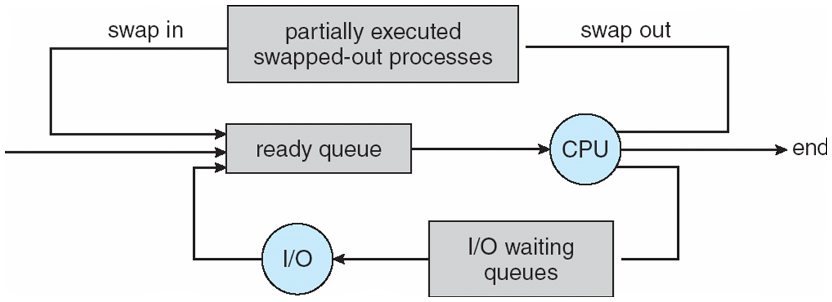
Addition of Medium Term Scheduling
Medium-term scheduler can be added if degree of multiple programming needs to decrease
Remove process from memory, store on disk, bring back in from disk to continue execution: swapping

Slide 5
Multitasking in Mobile Systems
Some mobile systems (e.g., early version of iOS) allow only one process to run, others suspended
Android runs foreground and background, with fewer limits
Background process uses a service to perform tasks
Service can keep running even if background process is suspended
Service has no user interface, small memory use

Slide 6
Context Switch
When CPU switches to another process, the system must save the state of the old process and load the saved state for the new process via a context switch
Context of a process represented in the PCB
Context-switch time is overhead; the system does no useful work while switching
The more complex the OS and the PCB ➔ the longer the context switch

Slide 7
Process Creation
Parent process create children processes, which, in turn create other processes, forming a tree of processes
Generally, process identified and managed via a process identifier (pid)

Slide 8
A Tree of Processes in Linux

Slide 9

Multiprocess Architecture – Chrome Browser
Many web browsers ran as single process (some still do)
If one web site causes trouble, entire browser can hang or crash
Google Chrome Browser is multiprocess with 3 different types of processes:
Browser process manages user interface, disk and network I/O
Renderer process renders web pages, deals with HTML, Javascript. A new renderer created for each website opened
Runs in sandbox restricting disk and network I/O, minimizing effect of security exploits
Plug-in process for each type of plug-in

Slide 10
Interprocess Communication
Processes within a system may be independent or cooperative
Cooperating processes need interprocess communication (IPC)
Two models of IPC
Shared memory
Message passing

Slide 11
Cooperating Processes
Independent process cannot affect or be affected by the execution of another process
Cooperating process can affect or be affected by the execution of another process
Advantages of process cooperation
Information sharing
Computation speed-up
Modularity
Convenience

